Slide 1
Multithreading
Implementing Interface Runnable
&
Extending Class Thread

Slide 2
Contents
Multitasking vs Multithreading
Process
Threads
Why Threading
Threads
Thread APIs
Creating and Terminating Threads
Threading Issues

Slide 3
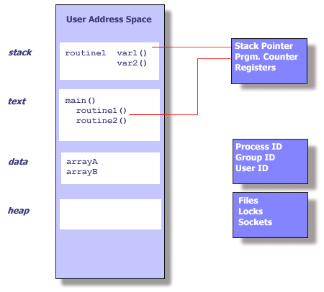
Process

Slide 4
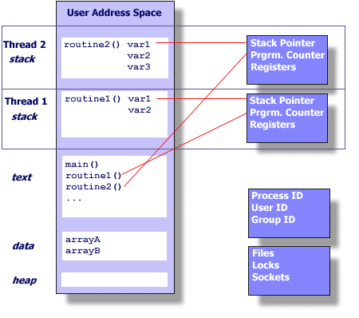
Thread

Slide 5
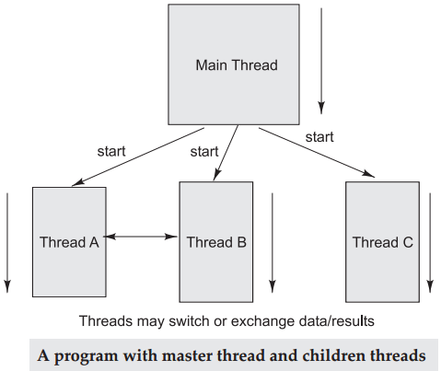
Thread Execution Flow

Slide 6
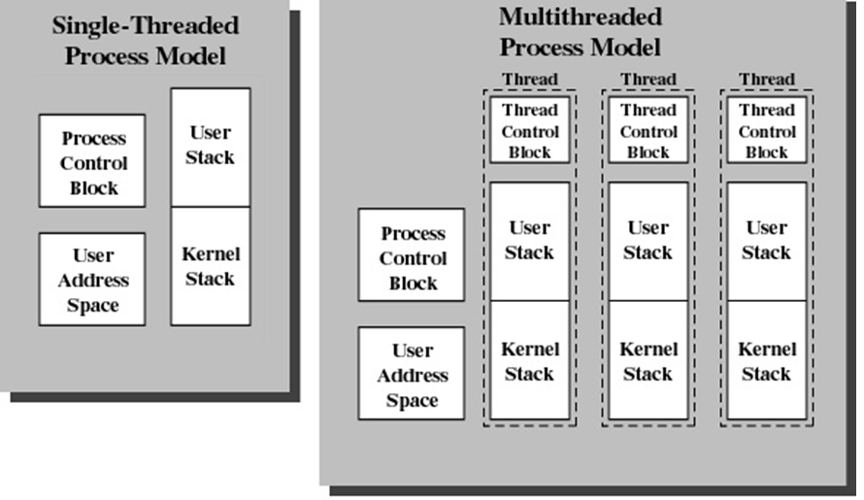
Multitasking vs Multithreading

Slide 7
Why Threading
Multitasking
fork()
Problems
Time to create new process
Memory requirements
Switching Time for scheduling
Solution
Multithreading

Slide 8
Benefits of Threads
Less time to
create a new thread than a process
terminate a thread than a process
switch between two threads within the same process
Since threads within the same process share memory and files, they can communicate with each other without invoking the kernel

Slide 9
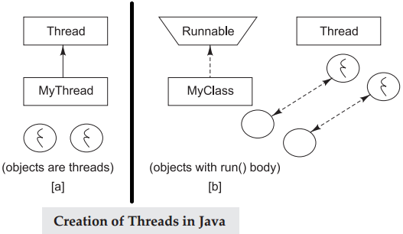
Java Thread

Slide 10
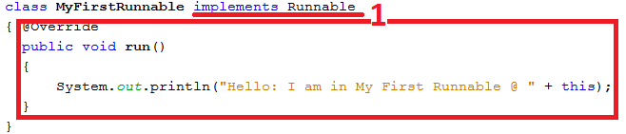
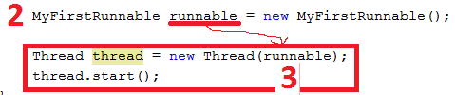
Implementing Runnable

Slide 11
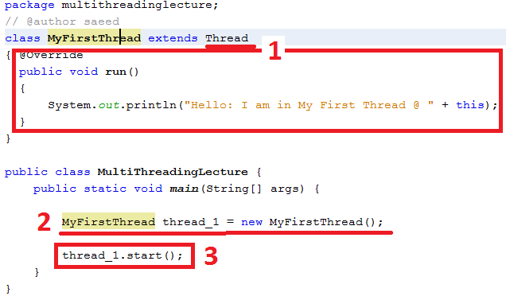

Extending Thread Class

Slide 12
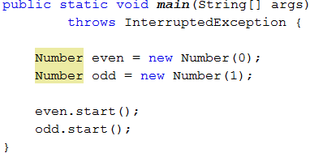
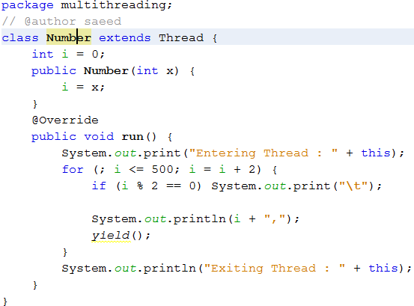
Even-Odd Numbers

Slide 13
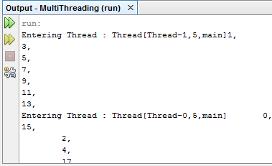
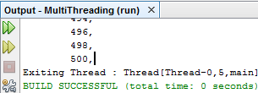
Output

Slide 14
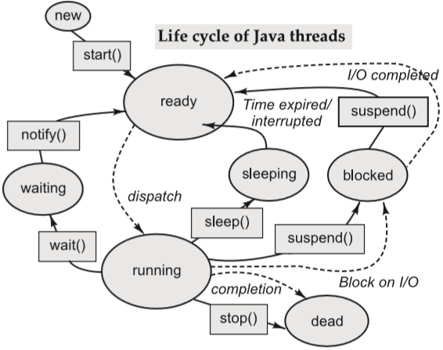
Thread functions & states

Slide 15
Advanced Topics in Multithreading
Issues
Concurrency control → Mutual Exclusion
Synchronization
Deadlock

Slide 16
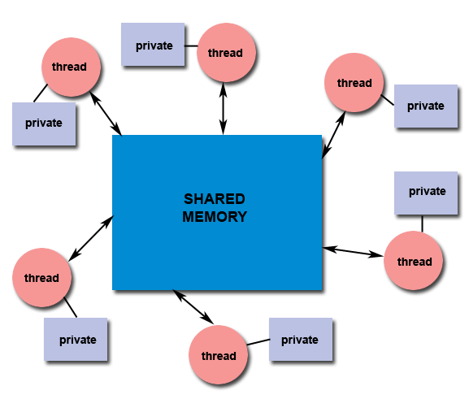
Shared Memory
All threads have access to the same global, shared memory
Threads also have their own private data
Programmers are responsible for synchronizing access (protecting) globally shared data.

Slide 17
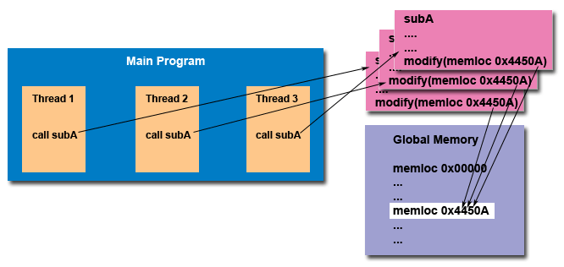
“Thread Safe”

Slide 18
Mutual Exclusion
To protect shared resources from race condition and data inconsistency.
Thread 1 | Thread 2 | Shared Data X
A = X |  | 100
 | B = X | 100
 | B = B + 300 | 100
A = A + 200 |  | 100
X = A |  | 300
 | X = B | 400

Slide 19
Thread Synchronization
When two or more threads are dependents on each other
Signaling a sleeping threads to wakeup

